Slide 1

CNSCC.203 Computer Networks Network Performance and Protocol Layers
Muhammad Azhar Iqbal
azhar.iqbal@lancaster.ac.uk
Credit goes to Dr. Matt Broadbent, Dr. Vasileios Giotsas, and Dr. Wenjuan Yu at SCC for designing module SCC.203.

Slide 2

Week 2: roadmap
Performance:
Delay
Loss
Throughput
Protocol layers, service models

Slide 3
Week 1: Recap
Computer Network (CN) Definition
CN Distinction and Advantages
Building Blocks of CN
Hardware
Core, Edge, Link (Medium)
Software
Network Architecture and Protocols
Types of CNs
Directly Connected
Point-to-Point
Multiple Access
Indirectly Connected (Switched)
Circuit-Switched
Packet Switched
Packet-Switched (Store-and-Forward)
Transmission Rate
Transmission Delay
Internet
Nuts and Bolts View
Service View
Internet Structure
Other Concepts
Protocols
(Protocols define the format, order of messages sent and received among network entities, and actions taken on msg transmission, receipt )
Access Network
(Network that physically connects an end system to the first (edge) router on a path from the end system to any other distant end system.)

Slide 4
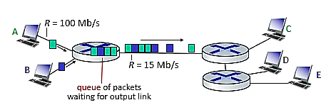
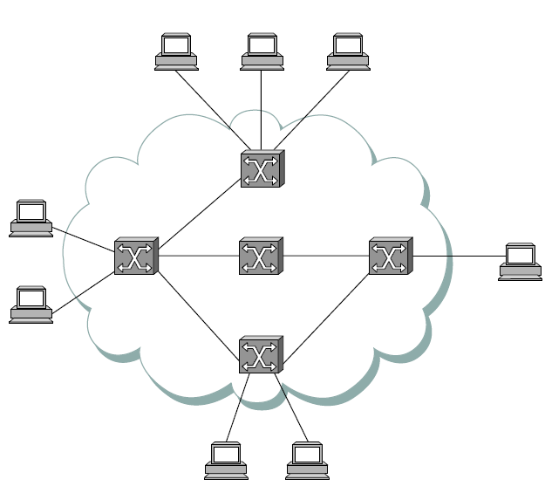
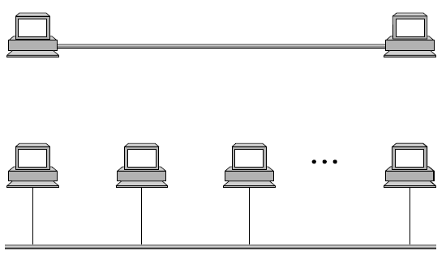
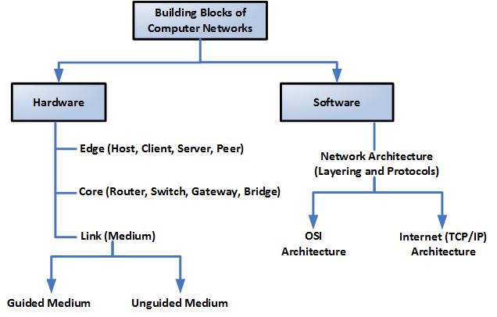
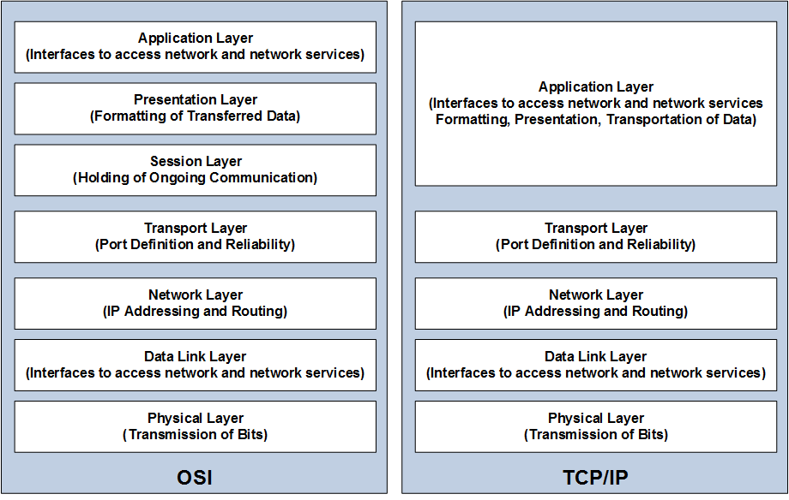
Week 1: Recap

Slide 5
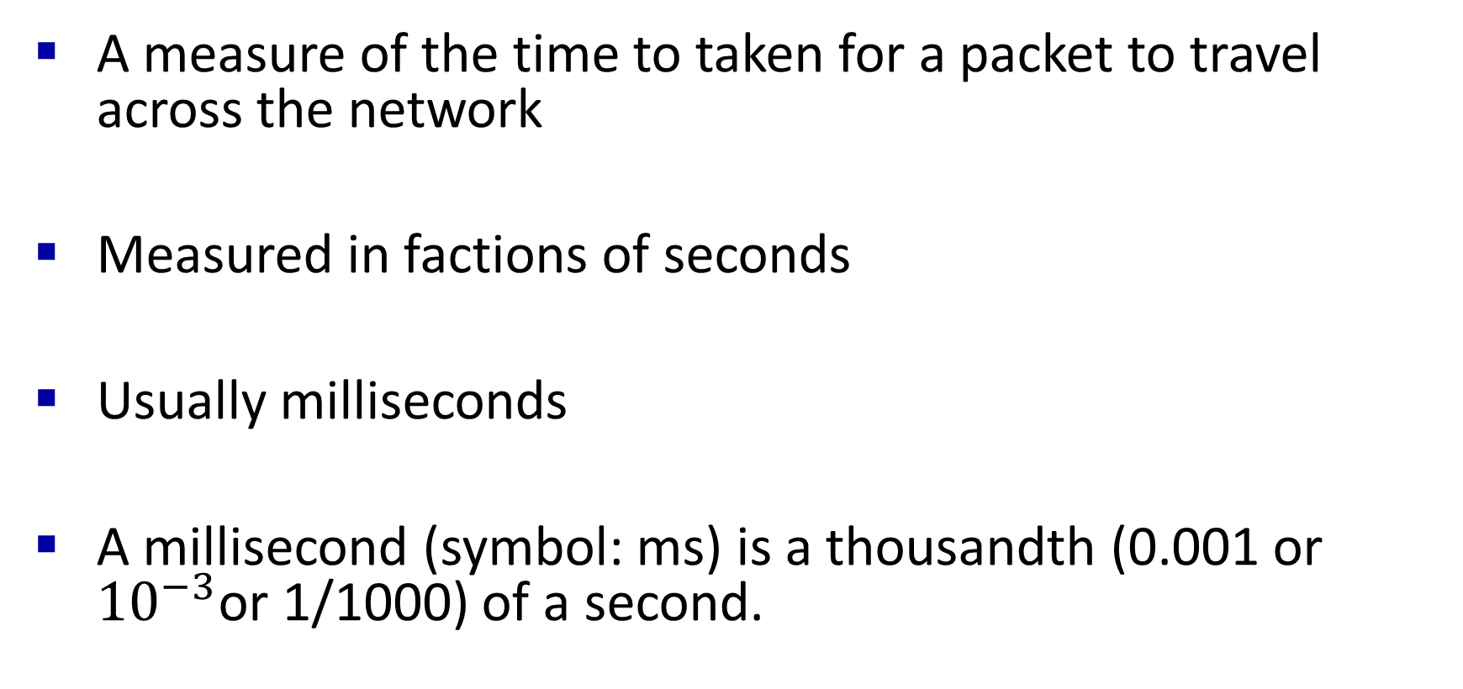
Delay overview
A measure of the time to taken for a packet to travel across the network
Measured in factions of seconds
Usually milliseconds
A millisecond (symbol: ms) is a thousandth (0.001 or ${10}^{−3}$or 1/1000) of a second.

Slide 6
Types of delay
4 main types of delay present in every network:
Processing delay
Queuing delay
Transmission delay
Propagation delay
Together, these are known as Nodal delay

Slide 7

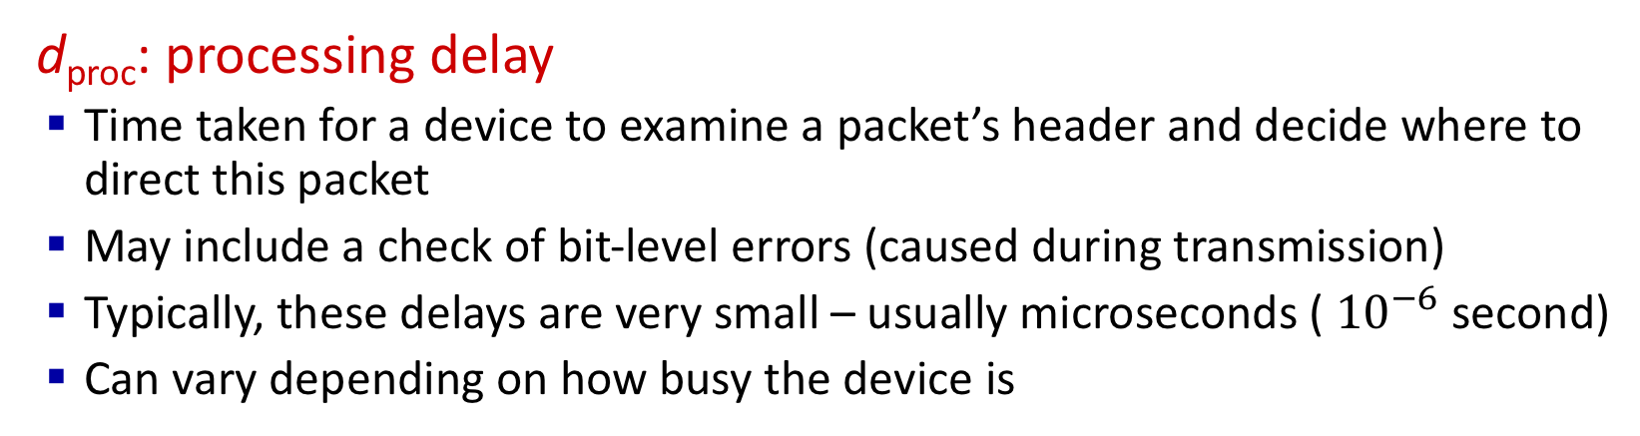
Packet delay: four sources
transmission
A
propagation
B
nodal
processing
queueing
d_{nodal} = d_{proc} + d_{queue} + d_{trans} + d_{prop}
d_{proc}: processing delay
Time taken for a device to examine a packet’s header and decide where to direct this packet
May include a check of bit-level errors (caused during transmission)
Typically, these delays are very small – usually microseconds ( ${10}^{−6}$ second)
Can vary depending on how busy the device is

Slide 8
Packet delay: four sources
transmission
A
propagation
B
nodal
processing
queueing
d_{nodal} = d_{proc} + d_{queue} + d_{trans} + d_{prop}
d_{queue}: queueing delay
Once a packet has been processed, it will join a queue
Here, it waits to leave the device
It will not be sent until it reaches the head of this queue
If the queue is empty and no other packet is currently being transmitted, then the newly arriving packet can be directly transmitted, and its queuing delay is zero.

Slide 9
Packet delay: four sources
transmission
A
propagation
B
nodal
processing
queueing
d_{nodal} = d_{proc} + d_{queue} + d_{trans} + d_{prop}
d_{queue}: queueing delay
The time spent waiting in this queue is the queuing delay, before it is transmitted --- typically on the order of microseconds to milliseconds in practice
The length of this queue, and thus the delay, is dependent on the congestion level of the router (e.g., the number of earlier-arriving packets that are queued)
A queue only occurs if the packet arrival rate to link (temporarily) exceeds output link capacity

Slide 10
Packet delay: four sources
transmission
A
propagation
B
nodal
processing
queueing
d_{nodal} = d_{proc} + d_{queue} + d_{trans} + d_{prop}
d_{trans}: transmission delay
Packets are transmitted once they reach the head of the queue
It is the time required for the router to push out the packet
For store-and-forward switching, the entire packet must be received before it is forwarded again

Slide 11
Packet delay: four sources
transmission
A
propagation
B
nodal
processing
queueing
d_{nodal} = d_{proc} + d_{queue} + d_{trans} + d_{prop}
d_{prop}: propagation delay
Once a bit is pushed into a link, it needs to propagate to the next device
It is the time it takes to propagate from one node to the next
The propagation speed depends on the physical medium of the link (that is, fibre link, twisted-pair copper wire etc) and is equal to, or a little less than the speed of light.

Slide 12
Packet delay: four sources
transmission
A
propagation
B
nodal
processing
queueing
d_{nodal} = d_{proc} + d_{queue} + d_{trans} + d_{prop}
d_{nodal}: nodal delay
Total of all previously mentioned types of delay
Measured per node (each device in a network)

Slide 13
Packet delay: four sources
transmission
A
propagation
B
nodal
processing
queueing
d_{nodal} = d_{proc} + d_{queue} + d_{trans} + d_{prop}
d_{trans}: transmission delay
L: packet length (bits)
R: link transmission rate (bps)
d_{trans} = L/R
d_{prop}: propagation delay
d: length of physical link (meter)
s: propagation speed (~2x10⁸ m/sec)
d_{prop} = d/s
d_{trans} and d_{prop}
very different

Slide 14
Transmission vs. propagation delay
A subtle difference, but important!
Transmission delay is the time required to push out the packet
Function of the packets lengths and the transmission rate of the link
Nothing to do with the distance between the two devices
Propagation delay is the time taken for a bit to propagate from one device to the next
Function of the distance between two devices
Nothing to do with the packet’s length or the transmission rate of the link

Slide 15
Packet delay – Quiz 1
Consider two hosts, A and B, connected by a single link of rate R bps. Suppose that the two hosts are separated by d meters, and suppose the propagation speed along the link is s meter/second. Host A is to send a packet of size L bits to Host B.
Q: Express the propagation delay, d_{prop}, in terms of d and s.
d_{prop} = d/s seconds
Q: Determine the transmission time of the packet, d_{trans}, in terms of L and R.
d_{trans} = L/R seconds
Q: Ignoring processing and queuing delays, obtain an expression for the end-to-end delay from Host A to Host B.
d_{end-to-end} = (d/s + L/R) seconds

Slide 16
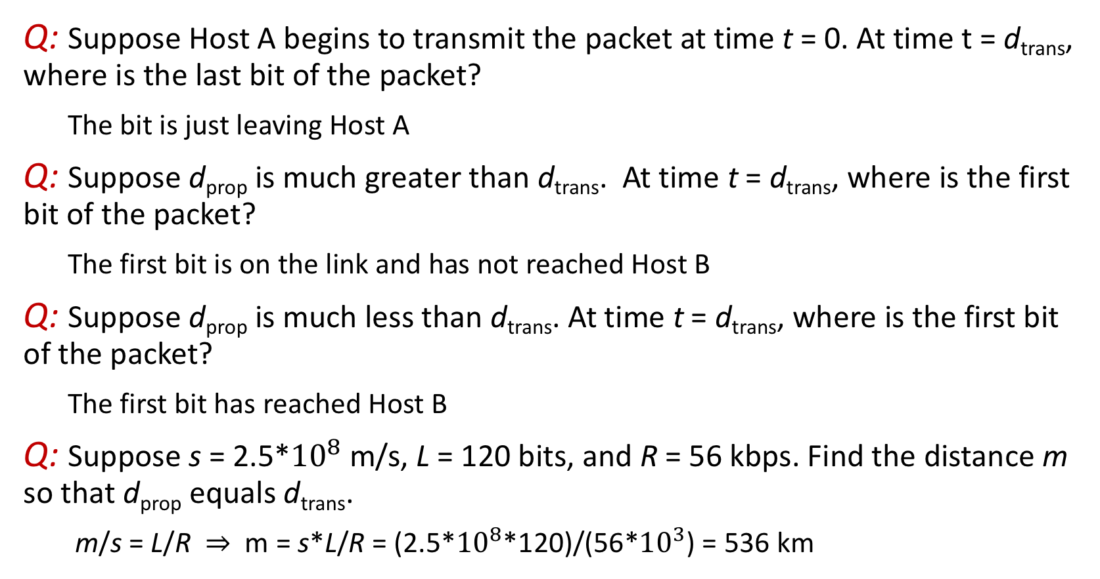
Packet delay – Quiz 1
Q: Suppose Host A begins to transmit the packet at time t = 0. At time t = d_{trans}, where is the last bit of the packet?
The bit is just leaving Host A
Q: Suppose d_{prop} is much greater than d_{trans}. At time t = d_{trans}, where is the first bit of the packet?
The first bit is on the link and has not reached Host B
Q: Suppose d_{prop} is much less than d_{trans}. At time t = d_{trans}, where is the first bit of the packet?
The first bit has reached Host B
Q: Suppose s = 2.5*${10}^{8}$ m/s, L = 120 bits, and R = 56 kbps. Find the distance m so that d_{prop} equals d_{trans}.
m/s = L/R $⇒$ m = s*L/R = (2.5*${10}^{8}$*120)/(56*${10}^{3}$) = 536 km

Slide 17
Packet delay – Quiz 2
Q: How long does it take a packet of length 1,000 bytes to propagate over a link of distance 2,500 km, propagation speed 2.5*10^8 m/s, and transmission rate 2 Mbps?
Hint: some irrelevant information is provided in the problem to mislead you.
Q: More generally, how long does it take a packet of length L (bits) to propagate over a link of distance d (meter), propagation speed s (m/s), and transmission rate R bps?
Hint: be careful with the units.
Q: Does this delay depend on packet length?
Q: Does this delay depend on transmission rate?

